Slide 1
TEXT QUALITY IN SEARCH –SUPPORTED WRITING
Supervised by: Michael Völske and Magdalena Wolska
12/03/2020
Presenter: Bibek Khadayat

Slide 2
Meaning full sentence at least with a verb and full stop is a good text.
Well organized, cohesive, coherence, readable etc. has high text quality.
Coherence Latin verb co-herence to stick together.
Coherence is Link or connection based on idea , concept or theme with smooth text flow.
Cohesion is on basis of grammar ,word, phrase or clause .
Readability is ease to understand the text, it depend on word selection , text format and organization
Overview
Notes:
A Text which contain a meaning full sentence at least with a verb and full stop in the end can be called good text
We can say, a text which is well organized, cohesive, coherence, readable etc. has high text quality.
Coherence is a link or connection between the sentences or text based on idea , concept or theme with smooth text flow.
Cohesion is link between the sentences or texts on basis of grammar ,word, phrase or clause and which give meaning to the text.
Readability of a text is ease with which reader can understand the text it depend on word selection , text format and organization

Slide 3
Text Quality
Cohesion
Coherence
Notes:
coherence is somehow a sub-problem of cohesion

Slide 4
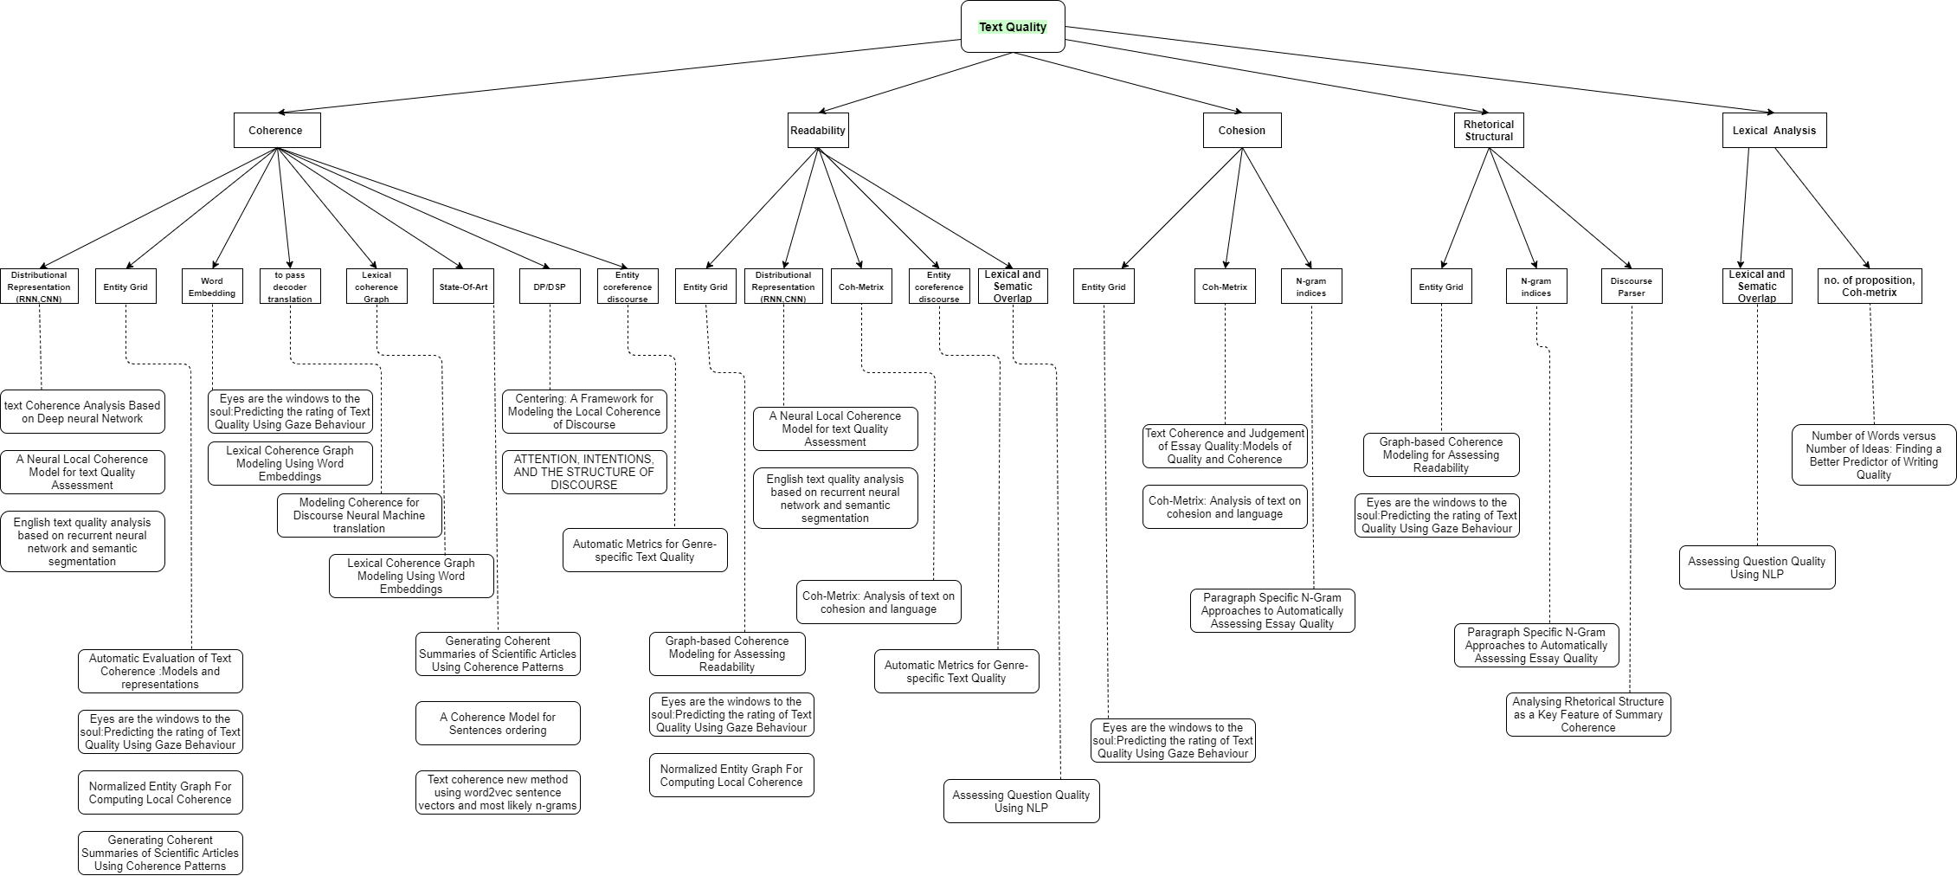
Literature Overview

Slide 5
Dataset https://webis.de/data/webis-trc-12.html
Webis Text reuse Corpus 2012 (Webis-TRC-12)
Is a manually written document by a hired writers at the crowdsourcing platform oDesk.
Each document in this corpus is about 150 topics used at TREC web tracks 2009-2011.
This corpus contain 150 topics with several revision documents in each topic

Slide 6
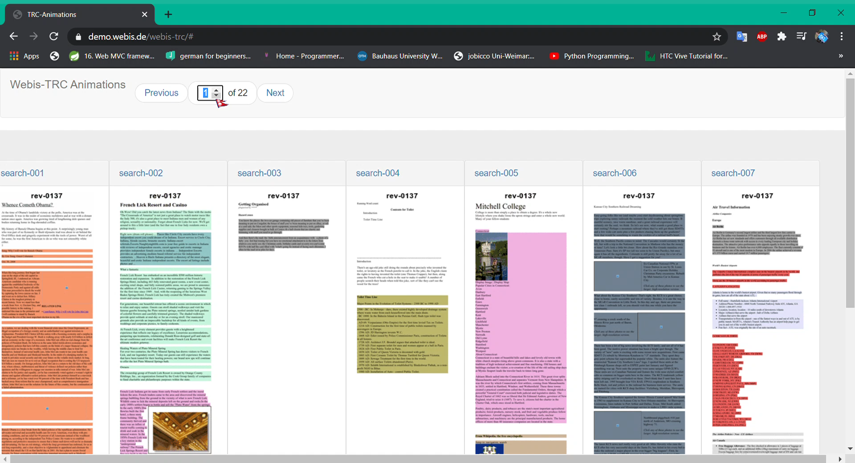

Slide 7
Goal
Find text quality of the essay included in the corpus specially Coherence feature.
Examine the sentence is coherent to the text or not.
Looking at the coherence of the essay’s sources , And checking whether that is predictive of a sources being included.
7

Slide 8


Thank you!

